Slide 1
A-Team
Albert Klorer, Jay Toebben, Nick Henry, Chase Alexander, Felipe Costa
Notes:
Nick

Slide 2
Project Description
The goal of this project is to analyze the energy usage of breaker boxes to improve energy efficiency and safety.
This is accomplished by monitoring the energy profile of breaker boxes, storing the data to a database, & using algorithms to analyze this data and provide wiring recommendations.
The energy profile of the breaker boxes and wiring recommendations can be viewed by accessing a web app.
Notes:
Nick

Slide 3
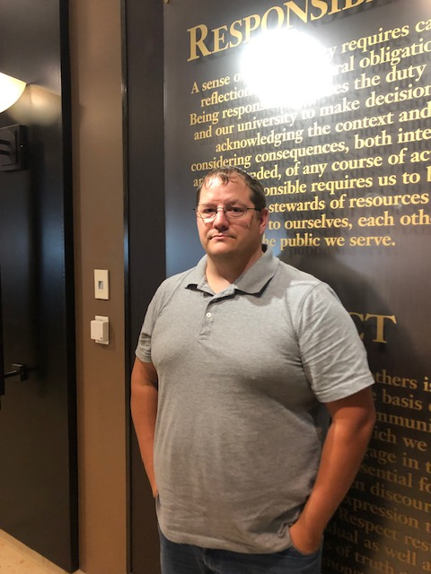
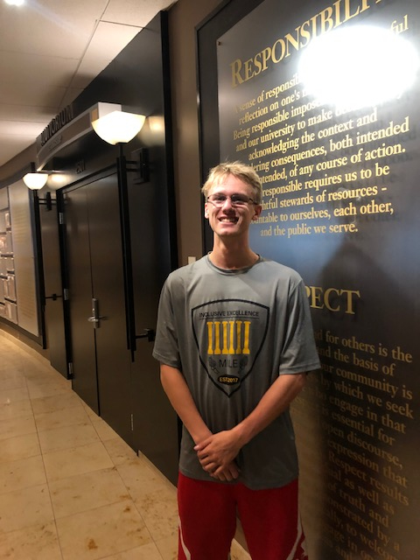
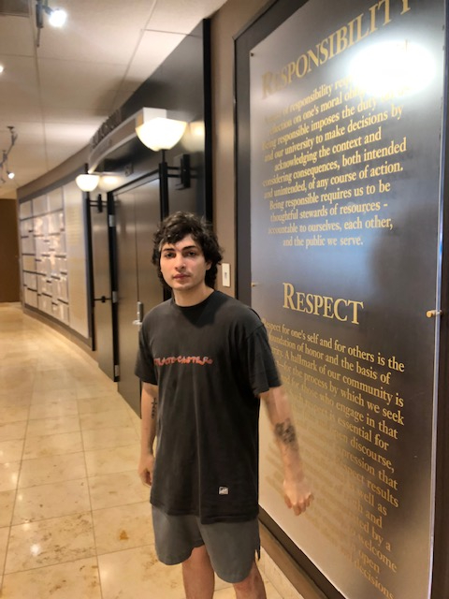
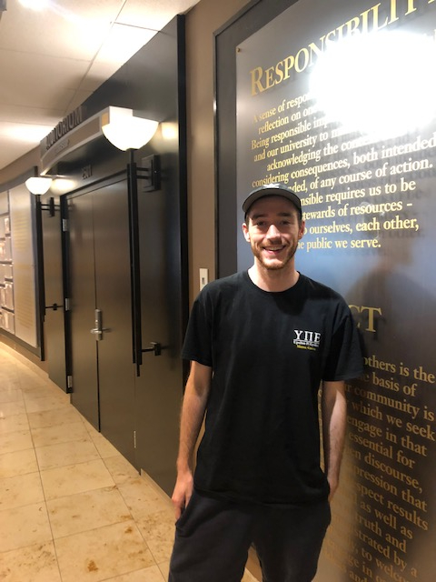
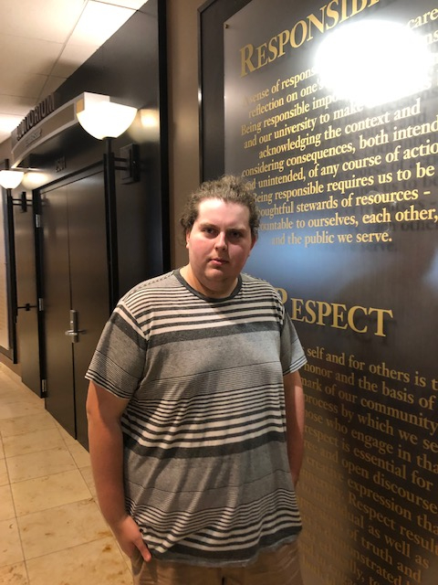
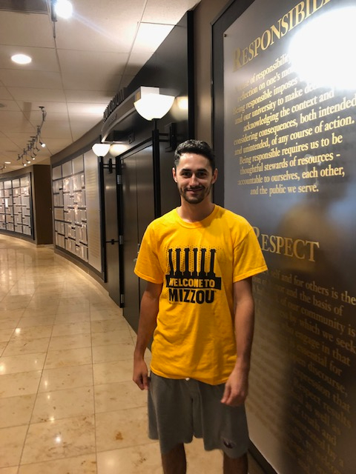
Team Responsibilities
Jay Toebben (Hardware & Ordering)
Tyler Nicewarner (Hardware & Backend)
Albert Klorer (Backend & Frontend)
Chase Alexander (Frontend)
Nick Henry (Frontend)
Felipe Costa (Frontend)
Notes:
Nick

Slide 4
Technical Content

Slide 5
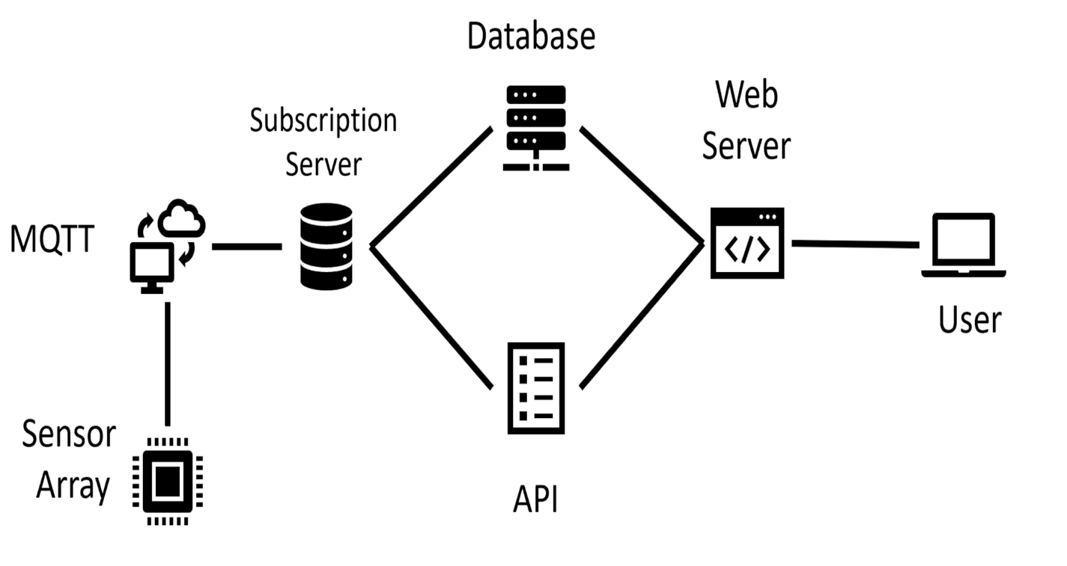
System Architecture
Notes:
Tyler

Slide 6
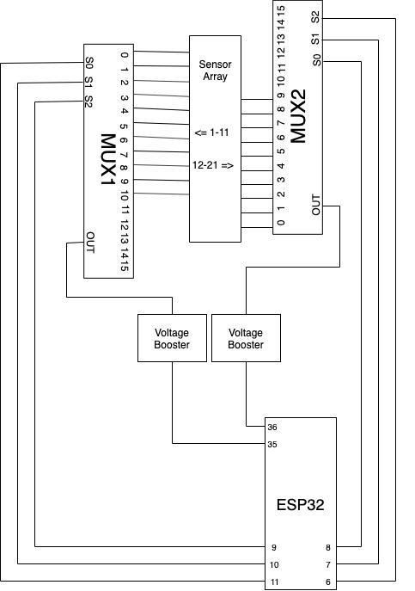
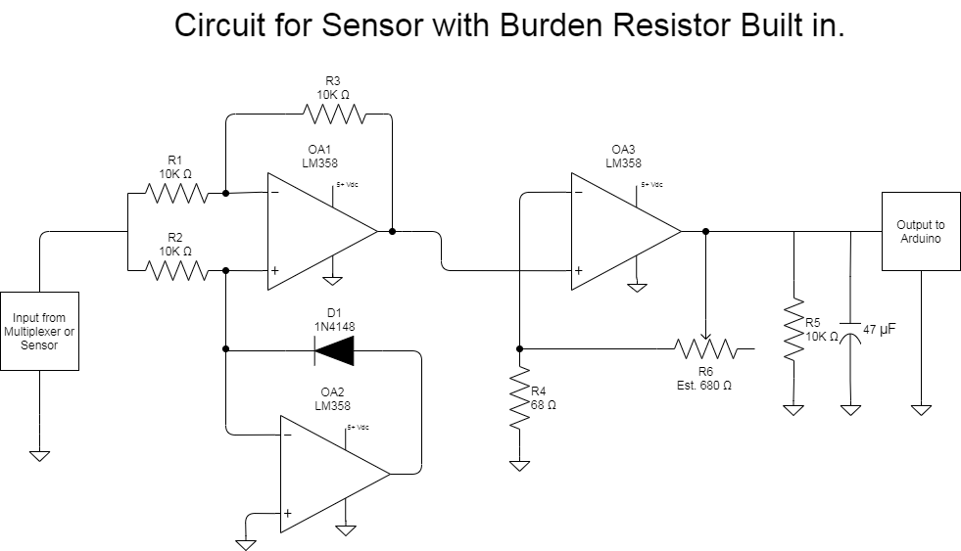
Hardware Design
Notes:
Tyler

Slide 7
Technologies
Arduino Library
MQTT Services
MongoDB
Angular
Nodejs
AWS
GitHub
GroupMe
Notes:
Chase

Slide 8
Design

Slide 9
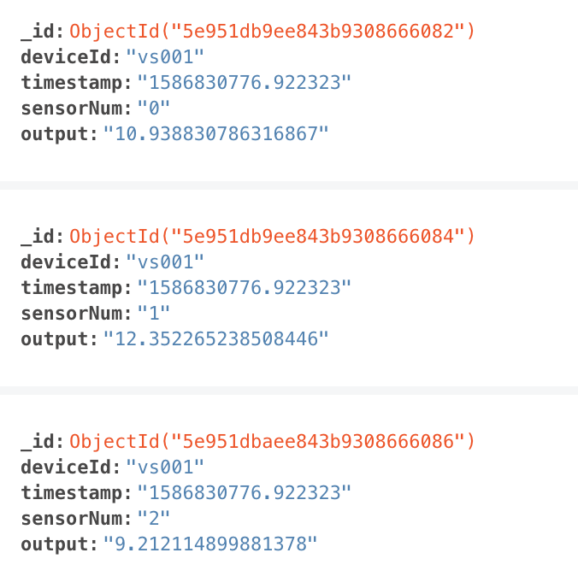
Database
To store sensor values we used a MongoDB database, which is running on an Amazon EC2 instance.
Values are entered into the database with the timestamp, device ID, and sensor ID as the unique identifiers.
Notes:
Albert

Slide 10
API
To retrieve values from the database created an API using Node, which is running on the same EC2 instance that the Mongo database is running on.
To retrieve the most recent values for a sensor as a JSON object the user enters the sensor ID as the route.
Notes:
Albert

Slide 11
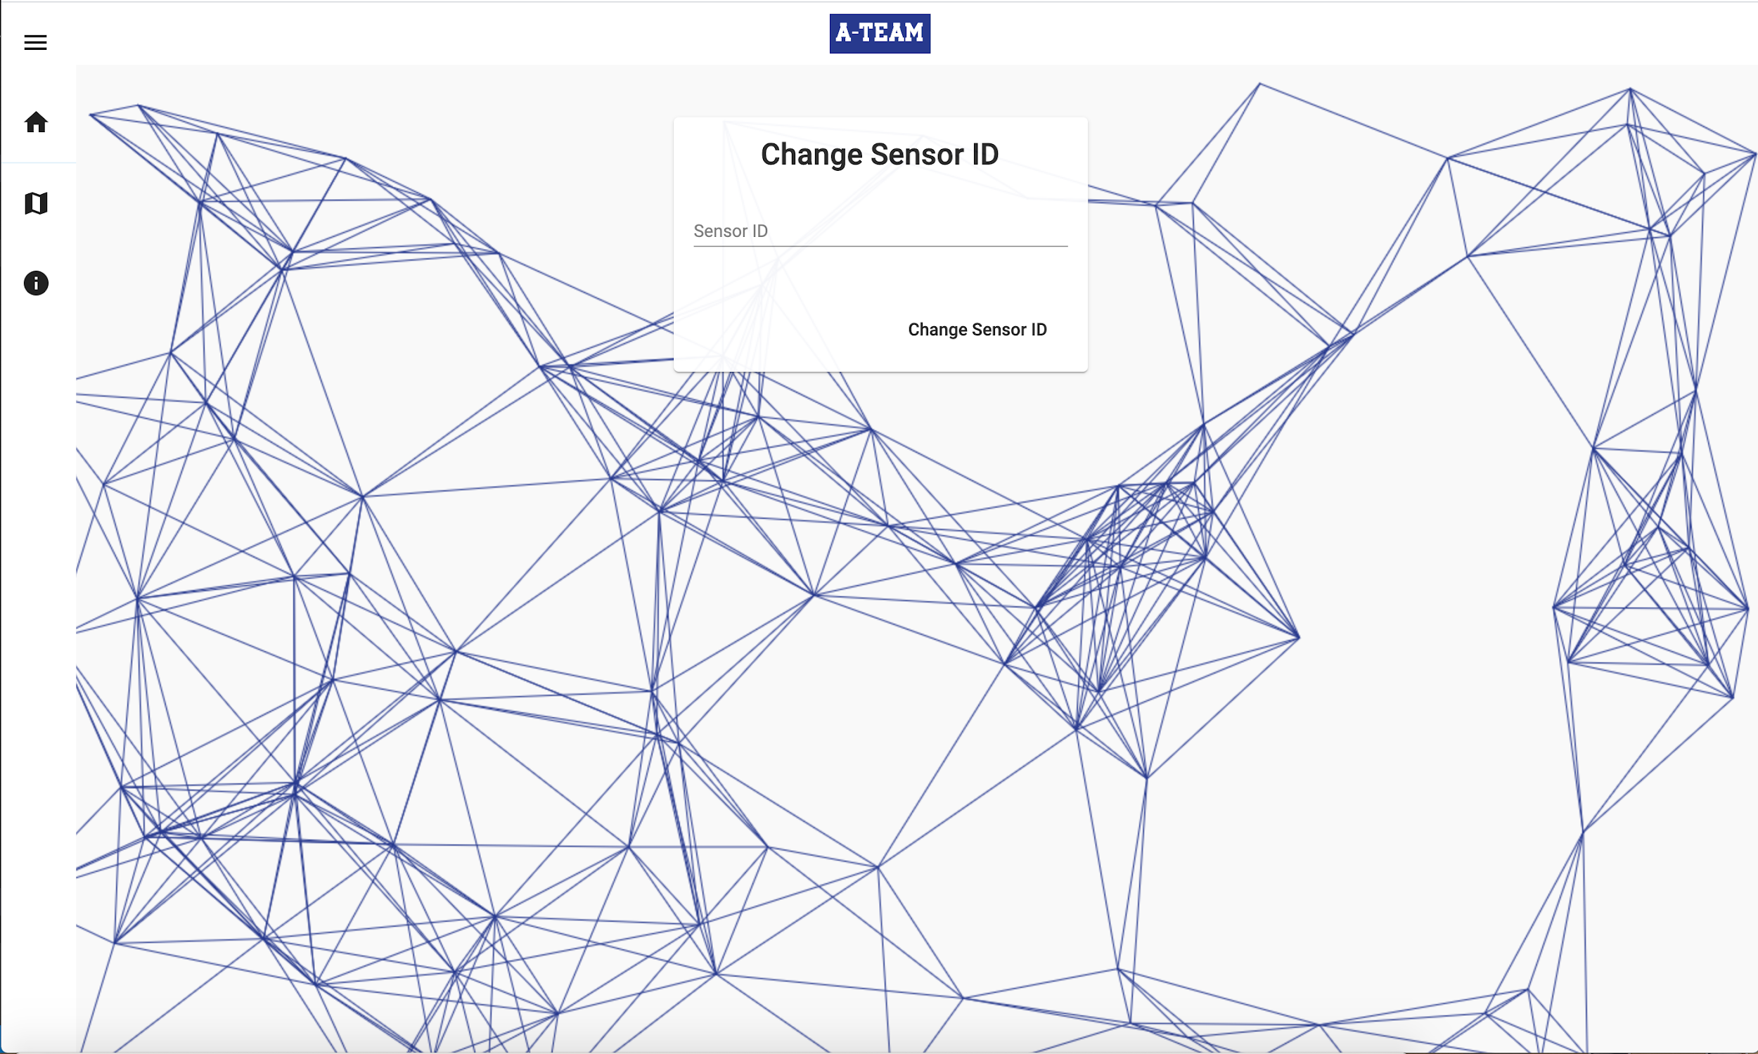
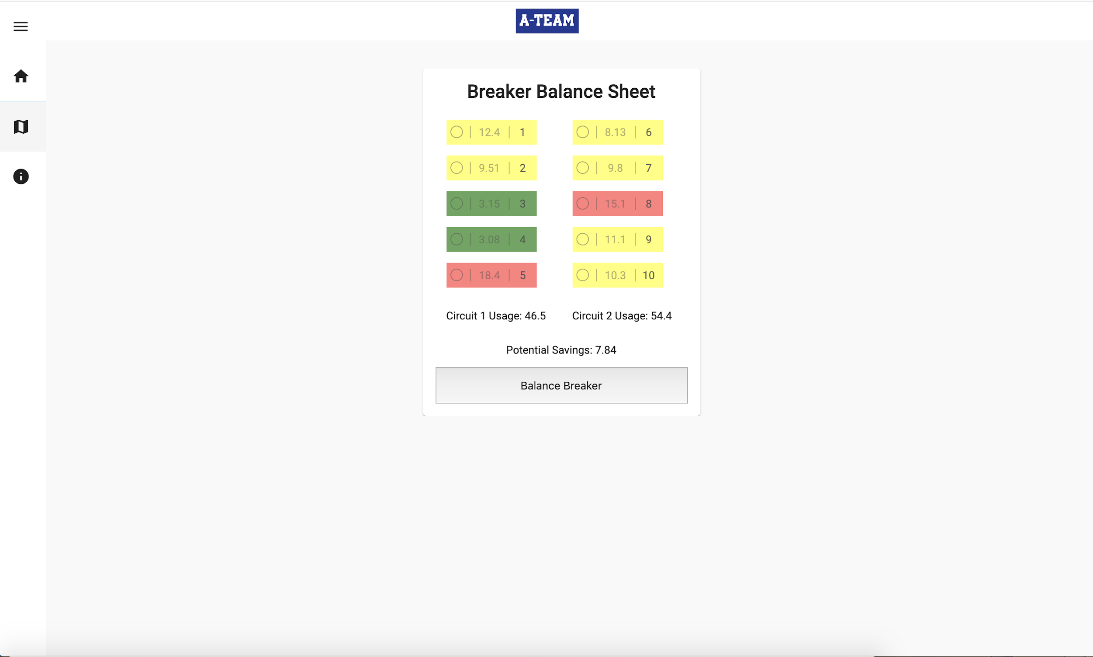
User Interface
Notes:
Albert

Slide 12
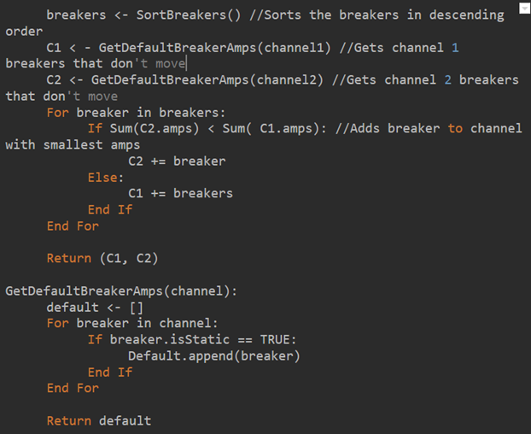
Breaker Balancing
We elected to make a simple algorithm to sort the breakers values, as the max number of breakers was only going to be 40
This is to balance the breakers to the closest possible values to each other to allow for the most cost effective energy usage
Notes:
Nick

Slide 13
Heatmap
Each breaker is colored based on the usage it is spending individually
Saving is calculating the difference in watts between a breakbox before and after being balanced
Difference in wattage is converted to kW/hr and then to cents/hr
Notes:
Nick

Slide 14
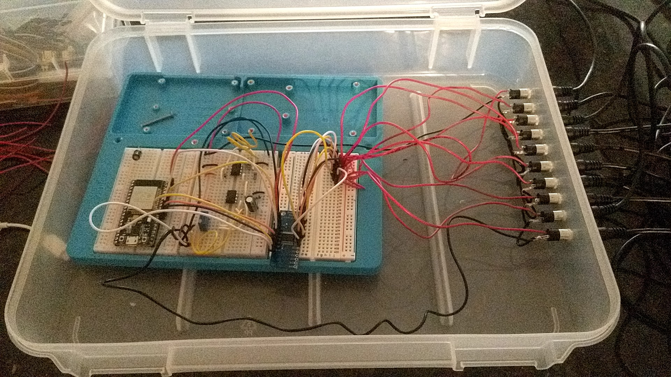
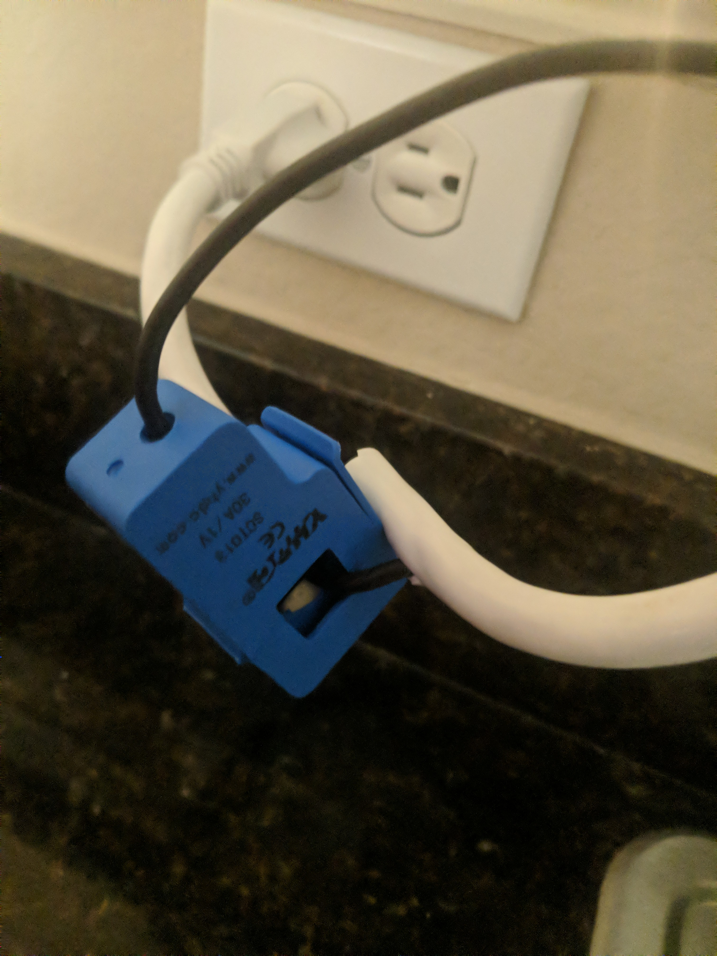
Hardware
Notes:
Tyler

Slide 15
Design Alternatives

Slide 16
Issues
Part Ordering
COVID-19
Faulty Part?
Notes:
Jay / Tyler

Slide 17
Virtual Sensor
We upgraded our virtual sensor array to behave more realistically so that we could create more feasible balancing recommendations.
Notes:
Albert

Slide 18
Circuit Design
A delay in parts being received coupled with the Corona Virus shutting campus down we had a limited amount of days to do hardware lab testing.
Once parts were received the team found the wrong sensor had been ordered.
When the correct sensor was received the team discover that the circuit would not work with the sensor.
In a rush the team designed and tested a new circuit.
Notes:
Jay

Slide 19

Circuit Design
The new Rectifier/Amplifier had to be designed using only the parts that the team had available due to the time constraints. This is the teams’ new design.
Notes:
Jay

Slide 20
Testing

Slide 21
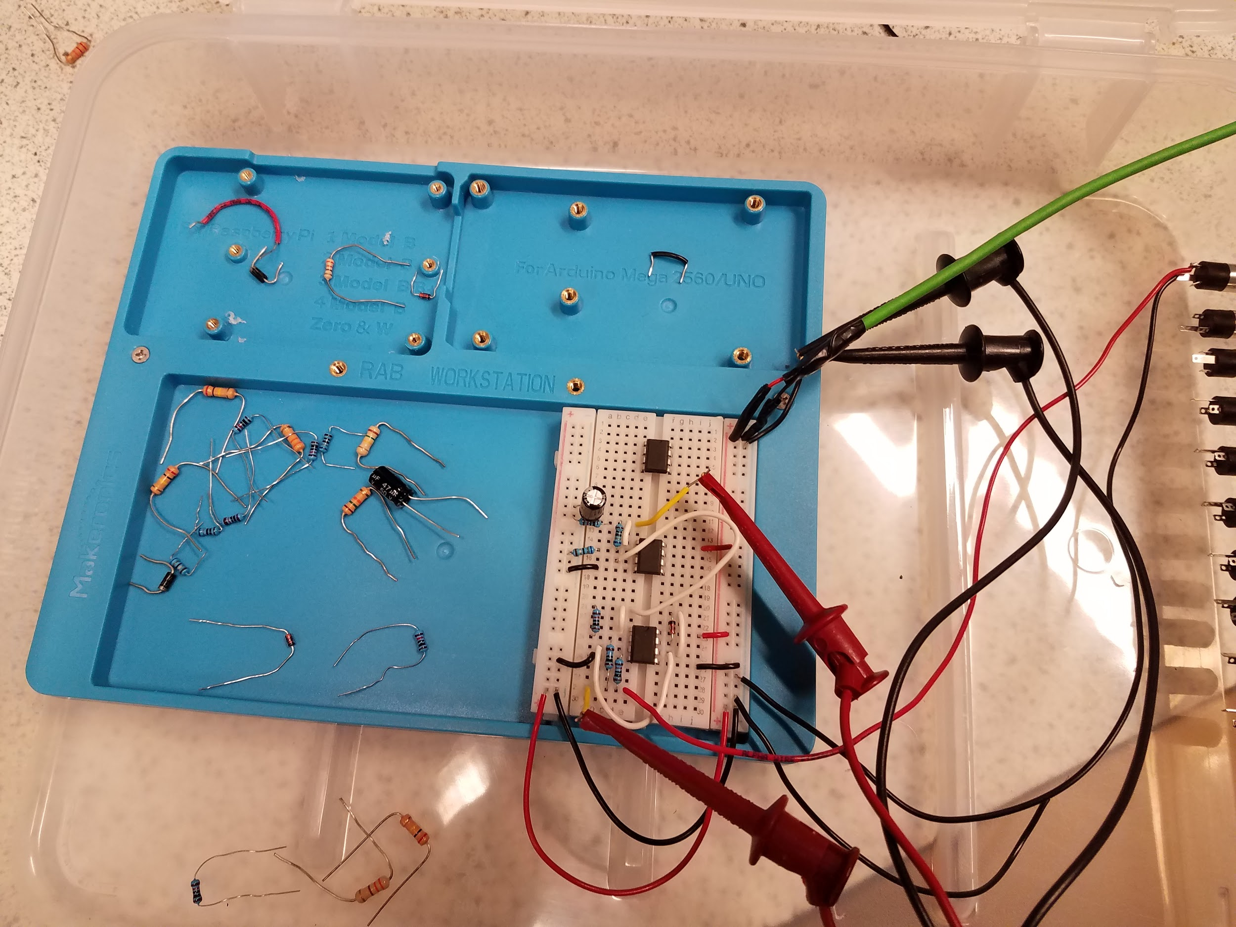
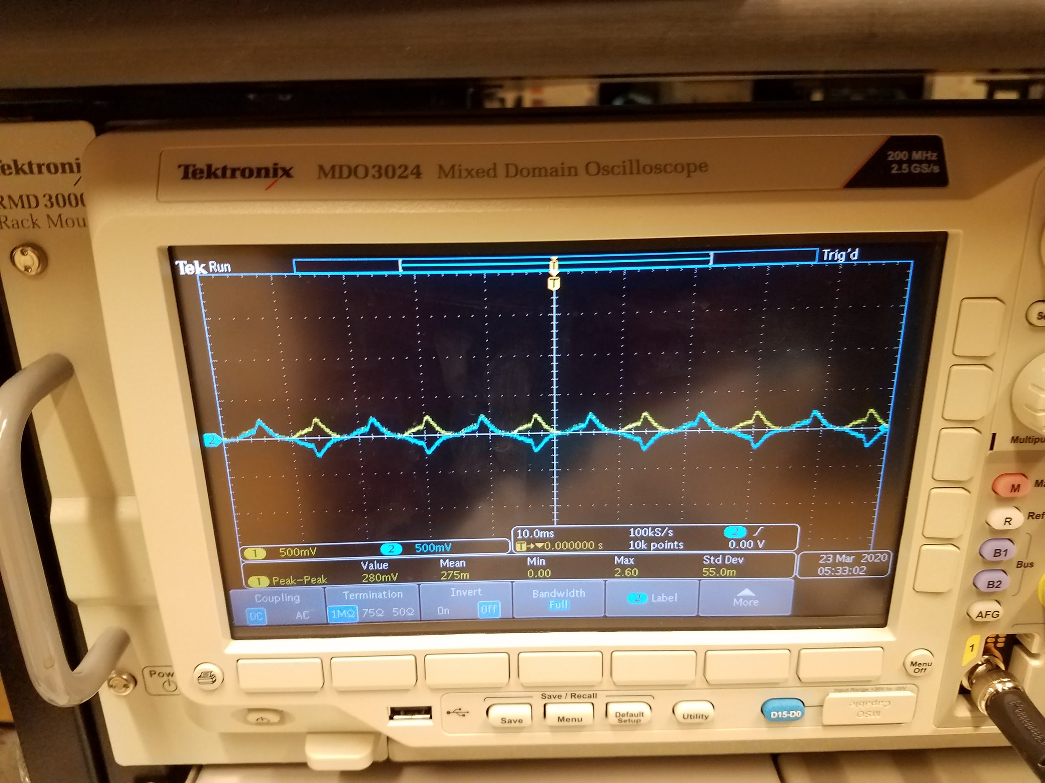
Circuit Testing
Under the time constraint the Team worked well and was able to get the Rectifier/Amplifier circuit designed, assembled and tested.
The first picture is of the assembled rectifier/amplifier circuit. The second is testing the rectifier part of the circuit.
Notes:
Jay

Slide 22
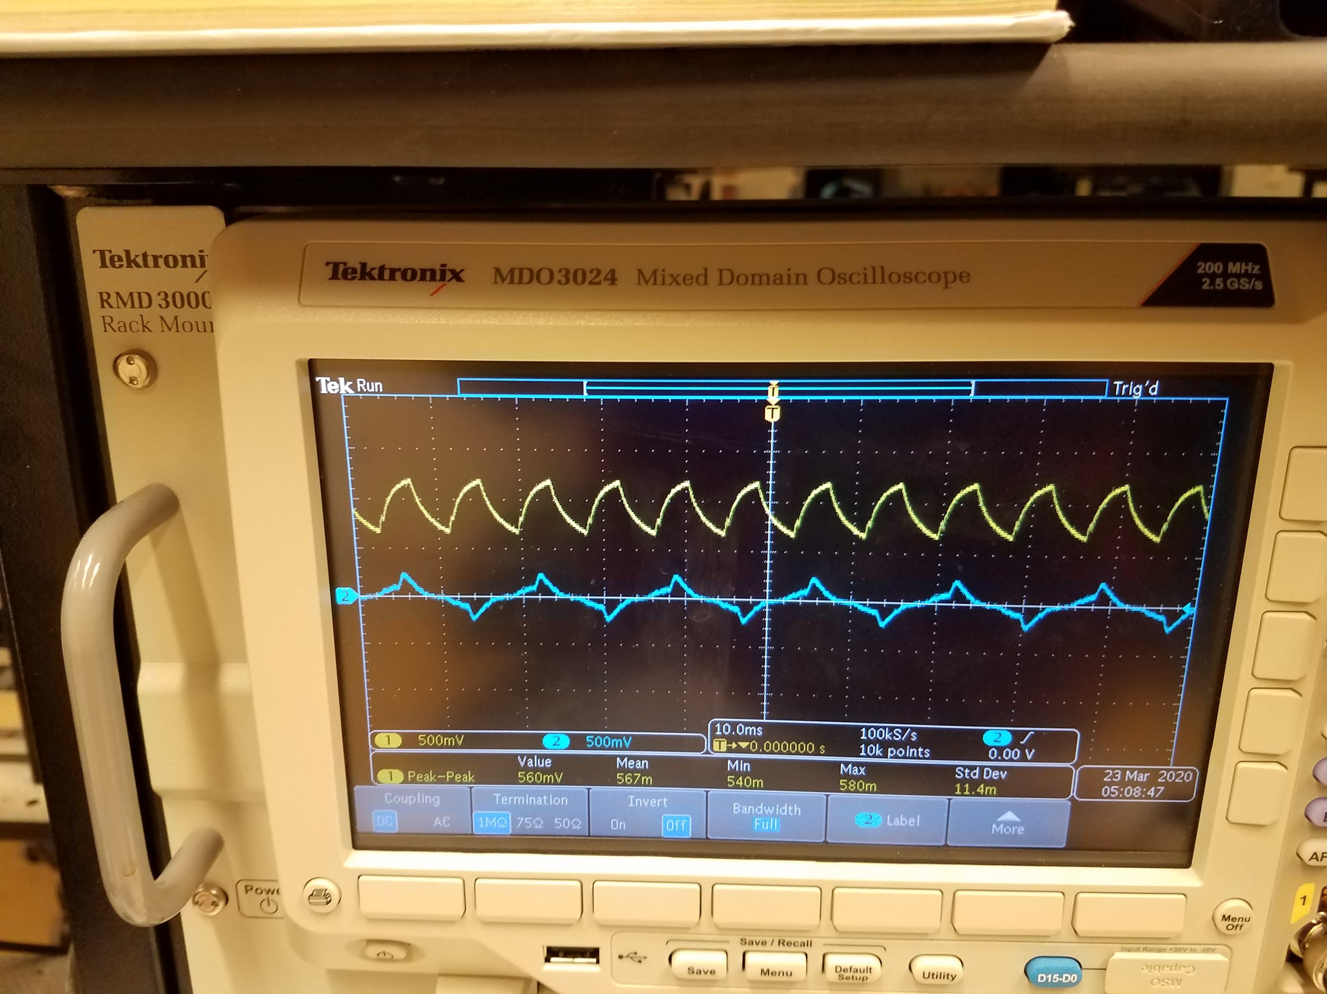
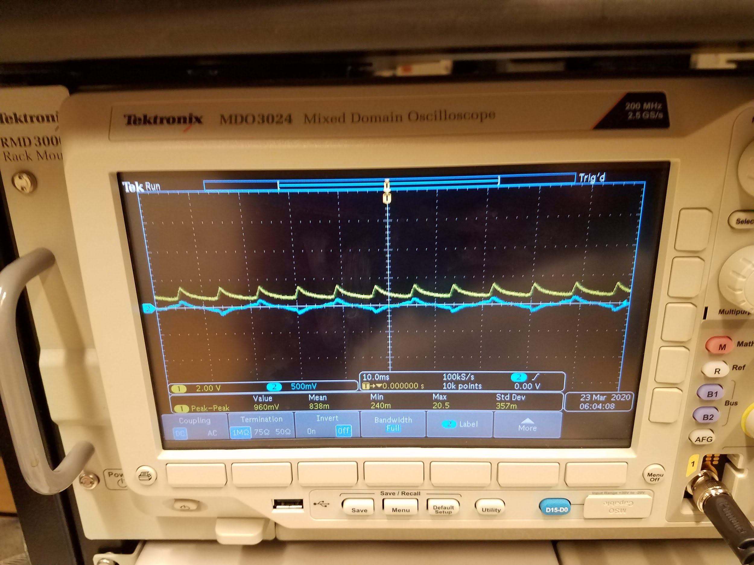
Circuit Testing
This shows first that the signal was amplified and later using a filter the peaks were softened. (Sorry about the scale difference between the pictures)
Notes:
Jay

Slide 23
Project Management

Slide 24
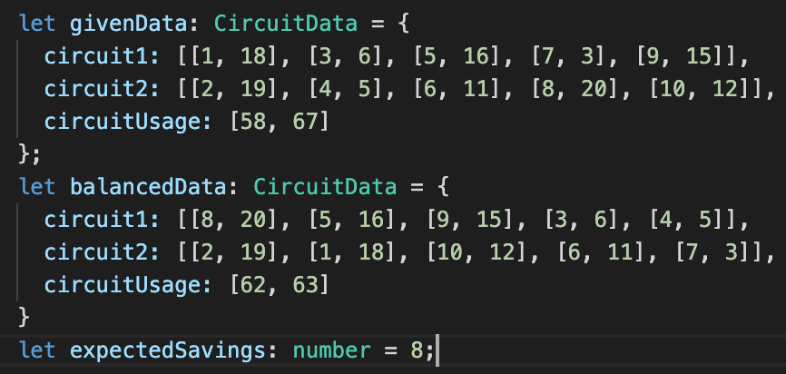
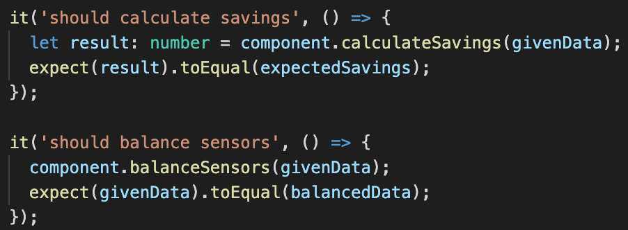
Software Testing
Angular Testing Framework(Jasmine)
Notes:
Chase

Slide 25
Timeline
Our hardware was initially delayed because of the ordering issues.
Immediately after we received our parts the COVID outbreak happened, which further delayed our work.
Software was slightly impacted because we had to create an alternative work plan and could no longer meet to work together as a group.
Notes:
Jay/Nick

Slide 26
Risk/Ethics

Slide 27
Risk & Ethics
Our hardware team recently was forced to meet to exchange parts, which was in violation of current stay at home orders.
We expose client data when performing breaker analysis, which would lead to customer information being leaked.
Notes:
Albert & Jay

Slide 28
Future Work

Slide 29
Hardware Goals
Self switching.
Expand size to monitor 40 channels instead of 10 so that it could be used in commercial contexts.
Notes:
Jay

Slide 30
Software Goals
The database is currently not set up in a way where it could scale to handle 1000s of breakers.
Changing this would require a small architecture change and would be needed before this
Notes:
Albert

